Slide 1
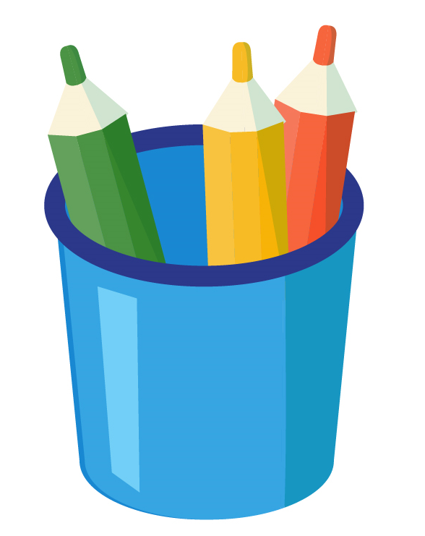
scissor
colored pencils

Slide 2
pencil
books

Slide 3
stapler
ruler

Slide 4
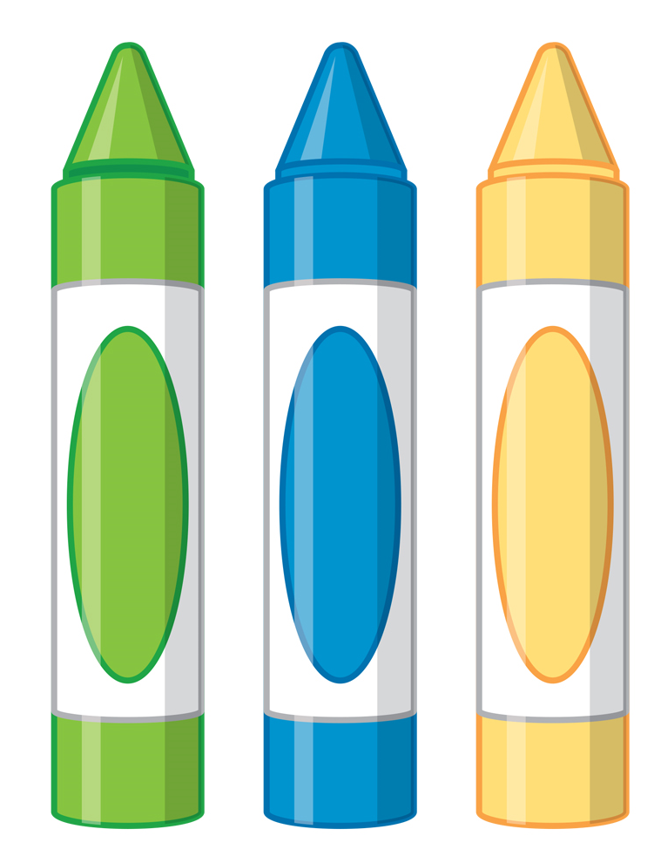
crayon
gom

Slide 5
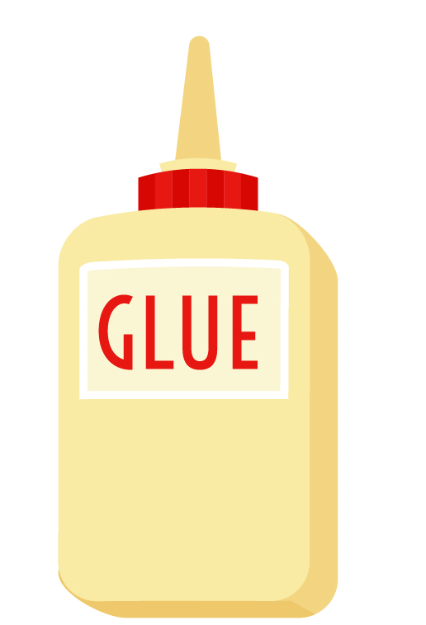
glue
paint brush

Slide 6
pencil sharpener
markers

